Slide 1
CSE447: Cryptography and Cryptanalysis
Spring 2025
Prepared by:
Dr. Muhammad Iqbal Hossain
Associate Professor
Department of CSE, Brac University

Slide 2


BracU
CRYPTO

Slide 3
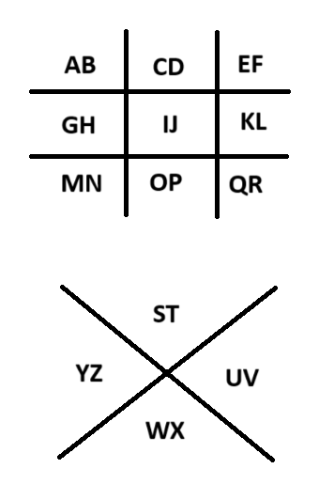

= A
= B
= S
= T
BracU
CRYPTO

Slide 4


How to get A in this course???

Slide 5
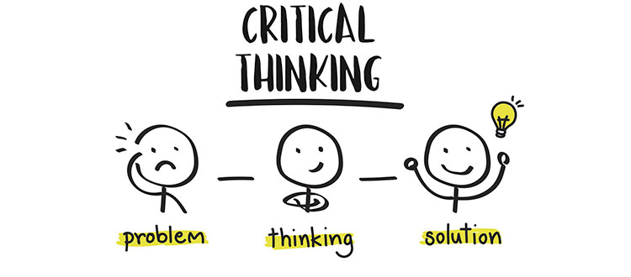

Slide 6

Chapter 1
Introduction
The cast of characters
Alice’s online Bank
About the text book

Slide 7
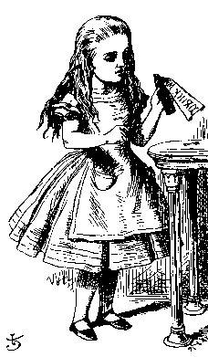
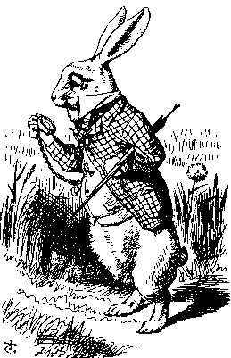
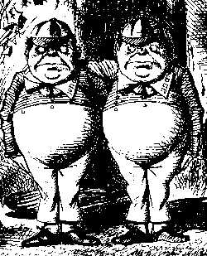
The Cast of Characters
Alice and Bob are the good guys
Trudy is the bad guy
Trudy is our generic “intruder”

Slide 8
Alice’s Online Bank
Alice opens Alice’s Online Bank (AOB)
What are Alice’s security concerns?
If Bob is a customer of AOB, what are his security concerns?
How are Alice and Bob concerns similar? How are they different?
How does Trudy view the situation?

Slide 9
CIA
CIA: Confidentiality, Integrity, and Availability
Confidentiality
  AOB must prevent Trudy from learning Bob’s account balance
  Confidentiality: prevent unauthorized reading of information
  Cryptography used for
  confidentiality

Slide 10
CIA
Integrity
  Trudy must not be able to change Bob’s account balance
  Bob must not be able to improperly change his own account balance
  Integrity: prevent unauthorized writing of information
    Cryptography used
    for integrity

Slide 11
CIA
Availability
  AOB’s information must be available when needed
  Alice must be able to make transaction
    If not, Bob’ll take his business elsewhere
  Availability: Data is available in a timely manner when needed
  Availability is a “new”
  security concern
    In response
    to denial of service (DoS)

Slide 12
Beyond CIA
CIA are only beginning of the Inf Sec.
Case 1: when Bob logs on his computer
  How does Bob’s computer know that “Bob” is really Bob and not Trudy?
Bob’s password must be verified
  This requires some clever cryptography
What are security concerns of pwds?
Are there alternatives to passwords?

Slide 13
Beyond CIA
Case 2: when Bob logs into AOB
  how does AOB know that “Bob” is really Bob?
As before, Bob’s password is verified
Unlike standalone computer case, network security issues arise
What are network security concerns?
  Protocols are critically important
  Crypto also important in protocols

Slide 14
Beyond CIA
Once Bob is authenticated by AOB, then AOB must restrict actions of Bob
  Bob can’t view Charlie’s account info
  Bob can’t install new software, etc.
Enforcing these restrictions is known as authorization
Access control includes both authentication and authorization

Slide 15
Beyond CIA
Cryptography, protocols, and access control are implemented in software
What are security issues of software?
  Most software is complex and buggy
  Software flaws lead to security flaws
  How does Trudy attack software?
  How to reduce flaws in software development?
And what about malware?

Slide 16
Beyond CIA
Some software is intentionally evil
  Malware: computer viruses, worms, etc.
How do the malwares work?
What can Alice and Bob do to protect themselves from malware?
What can Trudy do to make malware more “effective”?

Slide 17
Beyond CIA
Operating systems enforce security
  For example, authorization
OS: large and complex software
  Win XP has 40,000,000 lines of code!
  Subject to bugs and flaws like any other software
  Many security issues specific to OSs
  Can you trust an OS?

Slide 18
Text Book
The text consists of four major parts
  Cryptography
  Access control
  Protocols
  Software
Note: Our focus is on technical issues

Slide 19
The People Problem
People often break security
  Both intentionally and unintentionally
  Here, we consider the unintentional
For example, suppose you want to buy something online
  To make it concrete, suppose you want to buy from amazon.com

Slide 20
The People Problem
To buy from amazon.com…
  Your Web browser uses SSL protocol
  SSL relies on cryptography
  Access control issues arise
  All security mechanisms are in software
Suppose all of these security stuff works perfectly
  What could possibly go wrong?

Slide 21
The People Problem
What could go wrong?
Trudy can try man-in-the-middle attack
  SSL is secure, so attack doesn’t “work”
  Web browser issues a warning
  What do you, the user, do?
If user ignores warning, attack works!
  None of the security mechanisms failed
  But user unintentionally broke security

Slide 22
Think Like Trudy
Good guys must think like bad guys!
A police detective
  Must study and understand criminals
In information security
  We want to understand Trudy’s motives
  We must know Trudy’s methods
  We’ll often pretend to be Trudy

Slide 23
Think Like Trudy
Is all of this security information a good idea?
“It’s about time somebody wrote a book to teach the good guys what the bad guys already know.” ⎯ Bruce Schneier

Slide 24
Think Like Trudy
We must try to think like Trudy
We must study Trudy’s methods
We can admire Trudy’s cleverness
Often, we can’t help but laugh at Alice and Bob’s stupidity
But, we cannot act like Trudy
  Except in this class…

Slide 25
In This Course…
Always think like the bad guy
Always look for weaknesses
Strive to find a weak link
It’s OK to break the rules
Think like Trudy!
But don’t do anything illegal…

